Slide 1


SRI VENKATESHWARA COLLEGE OF ENGINEERING
AND TECHNOLOGY (AUTONOMOUS)
R.V.S Nagar, Chittoor – 517 127 (A.P)
Department of CSE (AI & ML)
YouTube Trending Analytics & Creator Insights
Project PPT
IV B.Tech – CSE (AI & ML) ‘B’
Submitted by:
  P.Rakshith Kumar Reddy (22781A33A3)
  S.Harish Kumar (22781A33A8)
  P.Sai Kumar (22781A33A1)
  V.Sravani (22781A33E3)
  K.Charan (23785A3307)
Guide:
Dr. M. Lavanya
HOD & Associate Professor
CSE (AI & ML)

Slide 2


Introduction
  YouTube is one of the largest digital content platforms where millions of videos are uploaded every day.
  Due to high competition, most creators struggle to gain reach and engagement.
  Traditional analytics provide only past statistics and lack prediction capability.
  There is a strong need for an intelligent, data-driven system to predict video performance before publishing.

Slide 3



Problem Statement
  No system to predict video trending before upload
  Manual analysis is time-consuming and inaccurate
  Creators rely on intuition instead of data
  Existing analytics are descriptive, not predictive
  Small creators lack intelligent decision support

Slide 4
Abstract
  This project presents an AI-based system to analyze YouTube video performance and predict trending probability and Click-Through Rate (CTR).
  Using historical YouTube data, machine learning models generate real-time predictions through a web dashboard.
  The system helps creators optimize content strategy, publishing time, and engagement for better visibility and growth.
Share Listing:
Technology services:
internet of things,
artificial intelligence,
and blockchain.
The company’s stock
has been listed on the
stock exchange since
April 24, 1995.
Authorized Capital:
Paid-Up Capital:
4 million USD consisting
of 60,000,000,000 shares
with a nominal value of 1
USD per share.
3 million USD consisting
of 40,483,553,140 shares
with a nominal value of
0.51 USD per share.

Slide 5




Project Strategy and Objectives
  To improve content planning and decision-making for YouTube creators, the project focuses on predictive analytics using machine learning.
  The system aims to transform traditional descriptive analytics into an intelligent, automated, and data-driven platform that assists creators before publishing videos.
Automate video performance prediction
Enable data-driven content strategy
Improve engagement and visibility

Slide 6
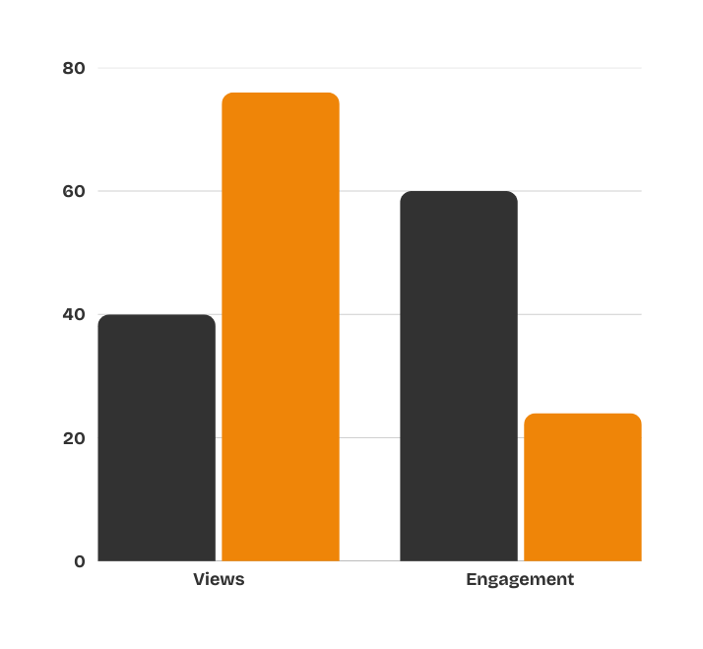



Business Model
Gauge
65%
  The system analyzes historical YouTube data and predicts video performance metrics such as trending probability and CTR.
  Creators input basic video details, and the platform generates real-time predictions through trained machine learning models.
  This model supports scalability, fast prediction, and creator-friendly insights.
CTR prediction
8.0%

Slide 7




System Coverage
  Data Sources:
  Multi-region YouTube Trending Datasets
  Models Used:
  Logistic Regression, Decision Tree, Random Forest
  Platform:
  Web-based Dashboard (Flask Framework)
10
15
Regions
Video Metrics

Slide 8
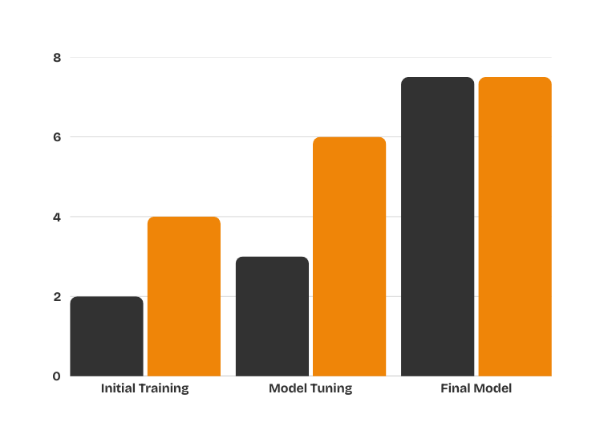

Consolidated System Performance
  During model evaluation, the overall system performance showed consistent improvement across all metrics.
  Prediction accuracy increased after feature engineering and model tuning.
  The Random Forest model demonstrated the most stable and reliable performance compared to other baseline models.
  This consolidated evaluation confirms the effectiveness of the proposed AI-based prediction system.

Slide 9
Assets
Baseline Model
Optimized Model
Evaluation
phase 1
phase 2
change
%
Current Assets
The system utilizes structured input features and engineered metrics to support accurate and reliable prediction of YouTube video performance.
Raw Input Features
6
5
+1
42%
Engagement Metrics
4
6
+2
16%
Engineered Features
3
5
+2
8%
Temporal Features
2
2
0
3%
Other Features
1
2
+1
2%
Total Model Assets
16
21
+5
72%

Slide 10
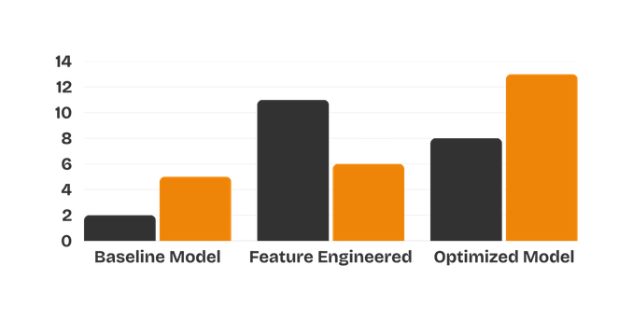

Model Performance Analysis
Prediction Accuracy (%)
  The proposed system demonstrates strong prediction capability with high accuracy and consistency.
  Feature engineering and ensemble learning significantly improved overall performance.
  The optimized model provides fast and reliable predictions suitable for real-time usage.

Slide 11
System Performance Highlights
  The optimized machine learning model achieved high prediction accuracy with consistent performance.
  Feature engineering and ensemble techniques significantly improved model reliability.
  The system delivers fast predictions, making it suitable for real-time YouTube analytics.

Slide 12
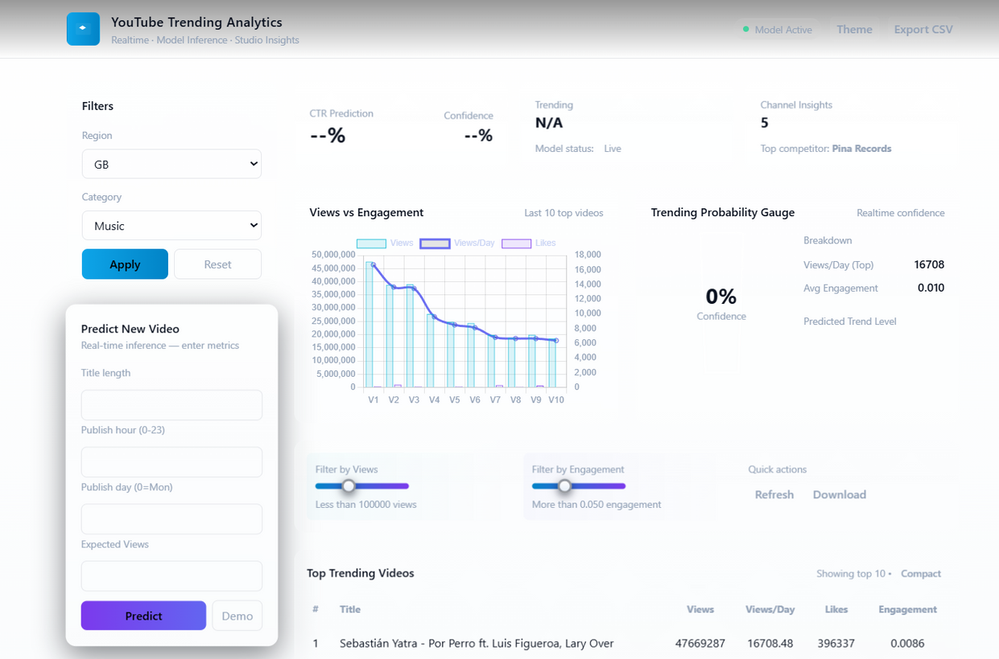

Output Screenshots

Slide 13
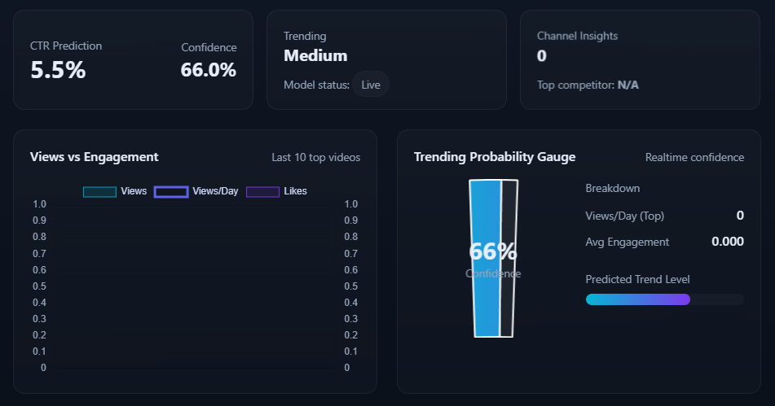

Slide 14
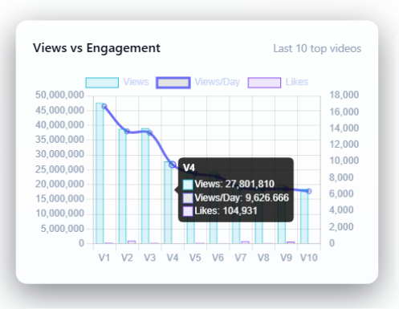
Output Screenshots

Slide 15
Results Summary
  Achieved high prediction accuracy using optimized ML models
  Feature engineering improved overall performance
  Random Forest delivered best results
  System provides fast and reliable predictions

Slide 16
Future Scope
  Integration with real-time YouTube API
  Advanced NLP for title and tag analysis
  Personalized creator recommendations
  Cloud deployment for scalability
  Support for more content categories

Slide 17
Conclusion
  Integration with real-time YouTube API
  Advanced NLP for title and tag analysis
  Personalized creator recommendations
  Cloud deployment for scalability
  Support for more content categories

Slide 18
Thank You
Thank you for your time and consideration.

